Slide 1


First Grade
Back to School
Mrs. Kamin
Divich ES
2020

Slide 2
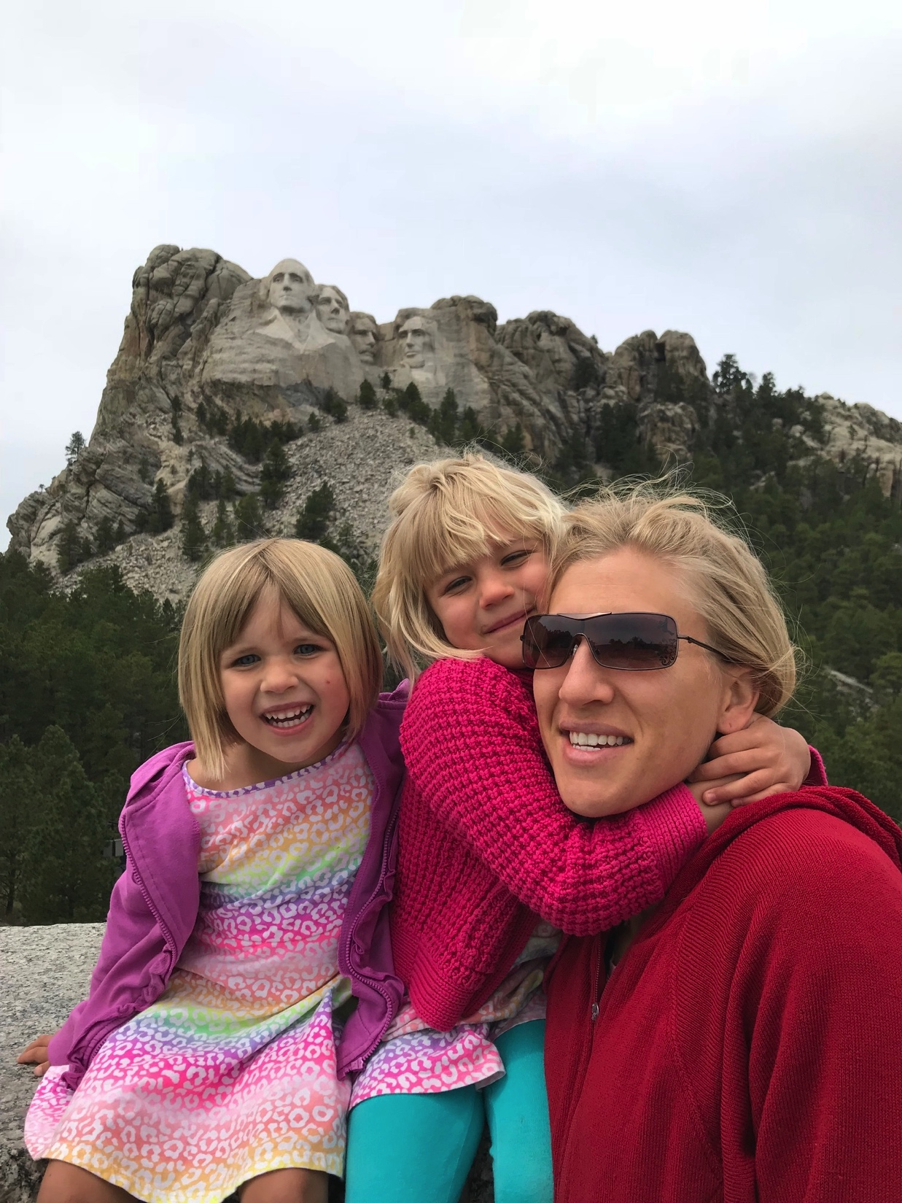
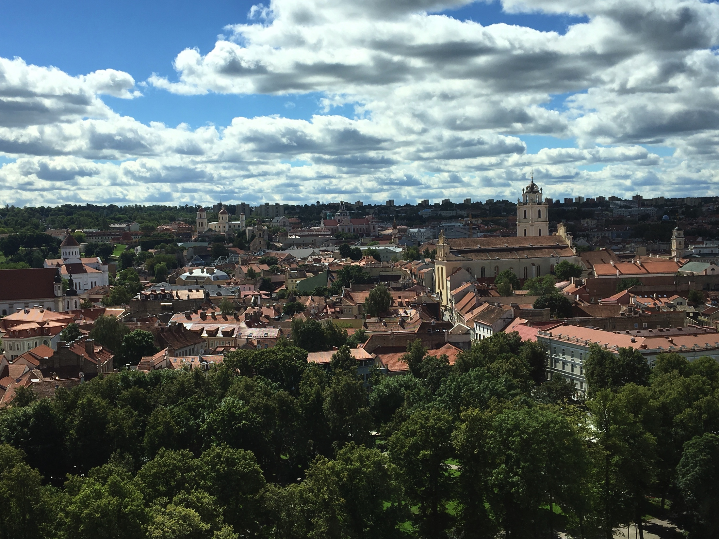
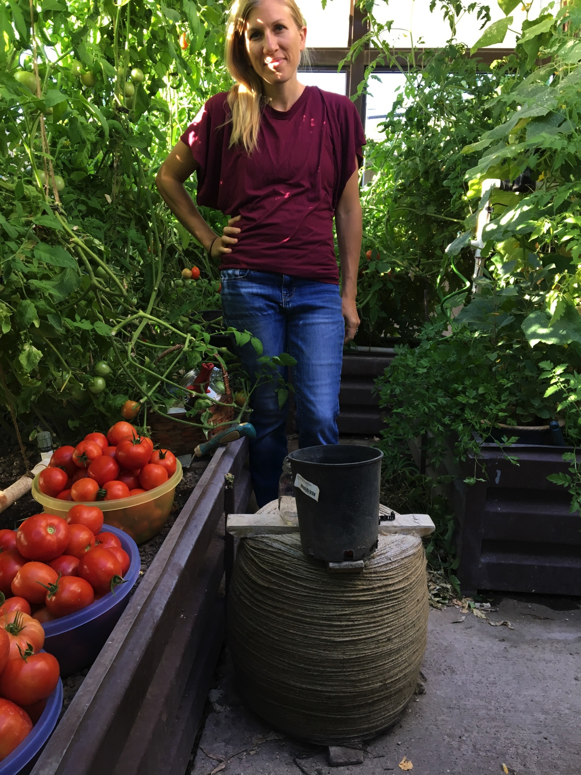
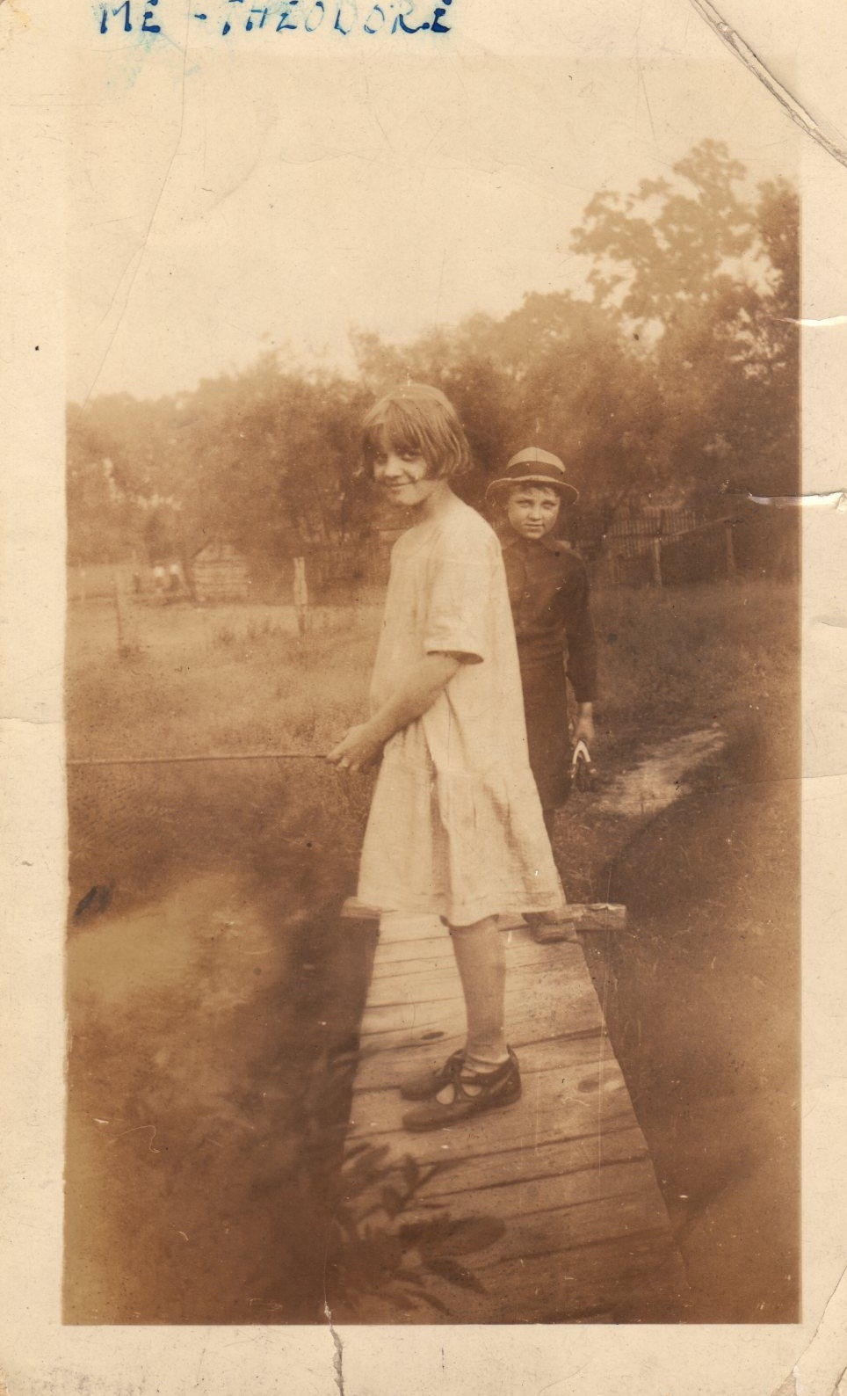
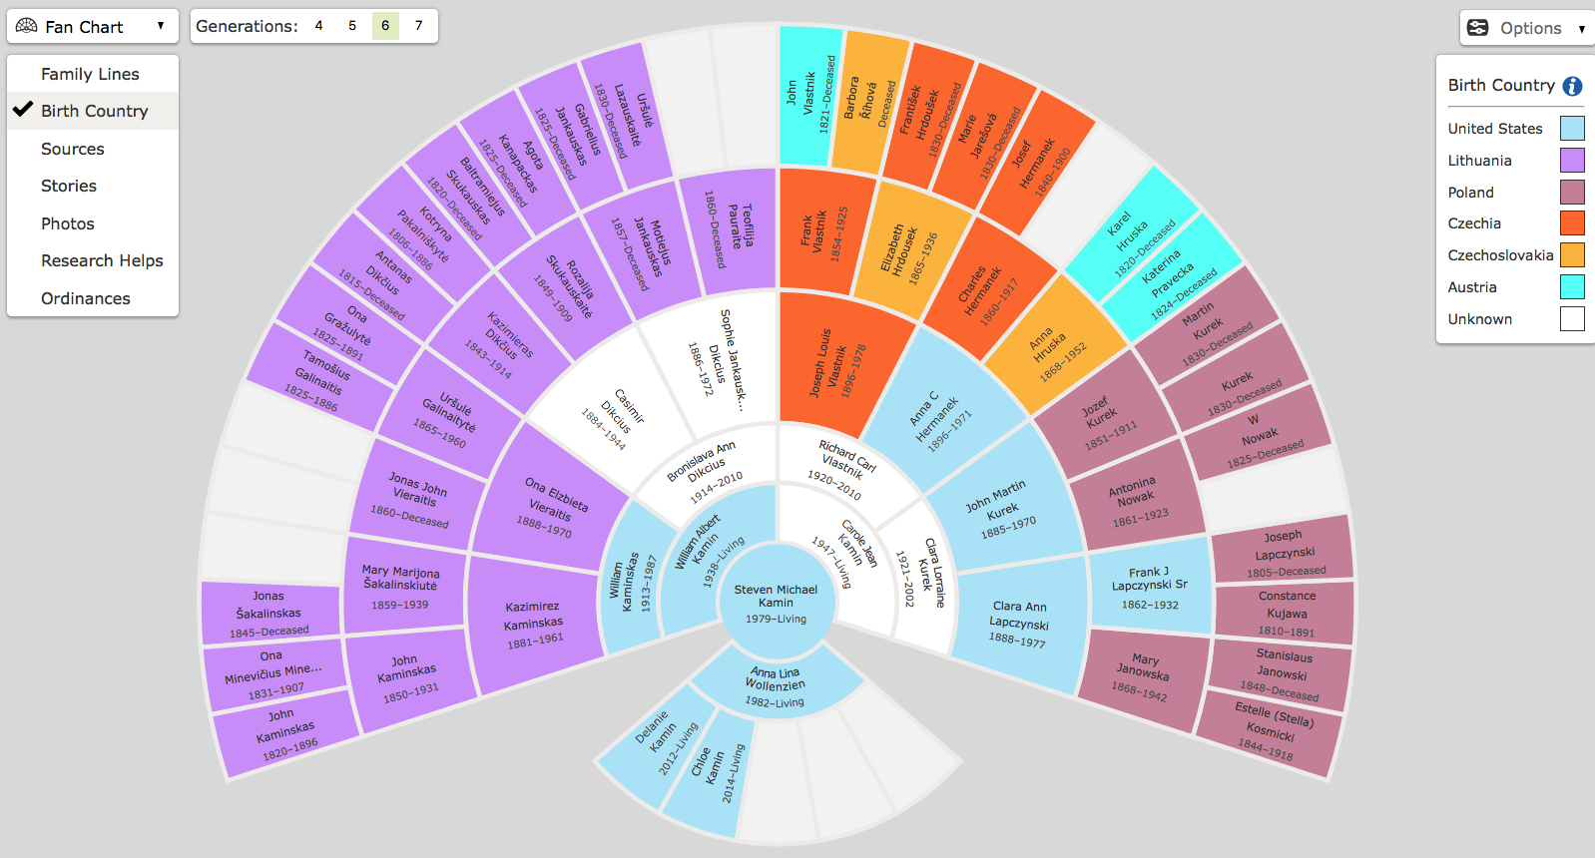

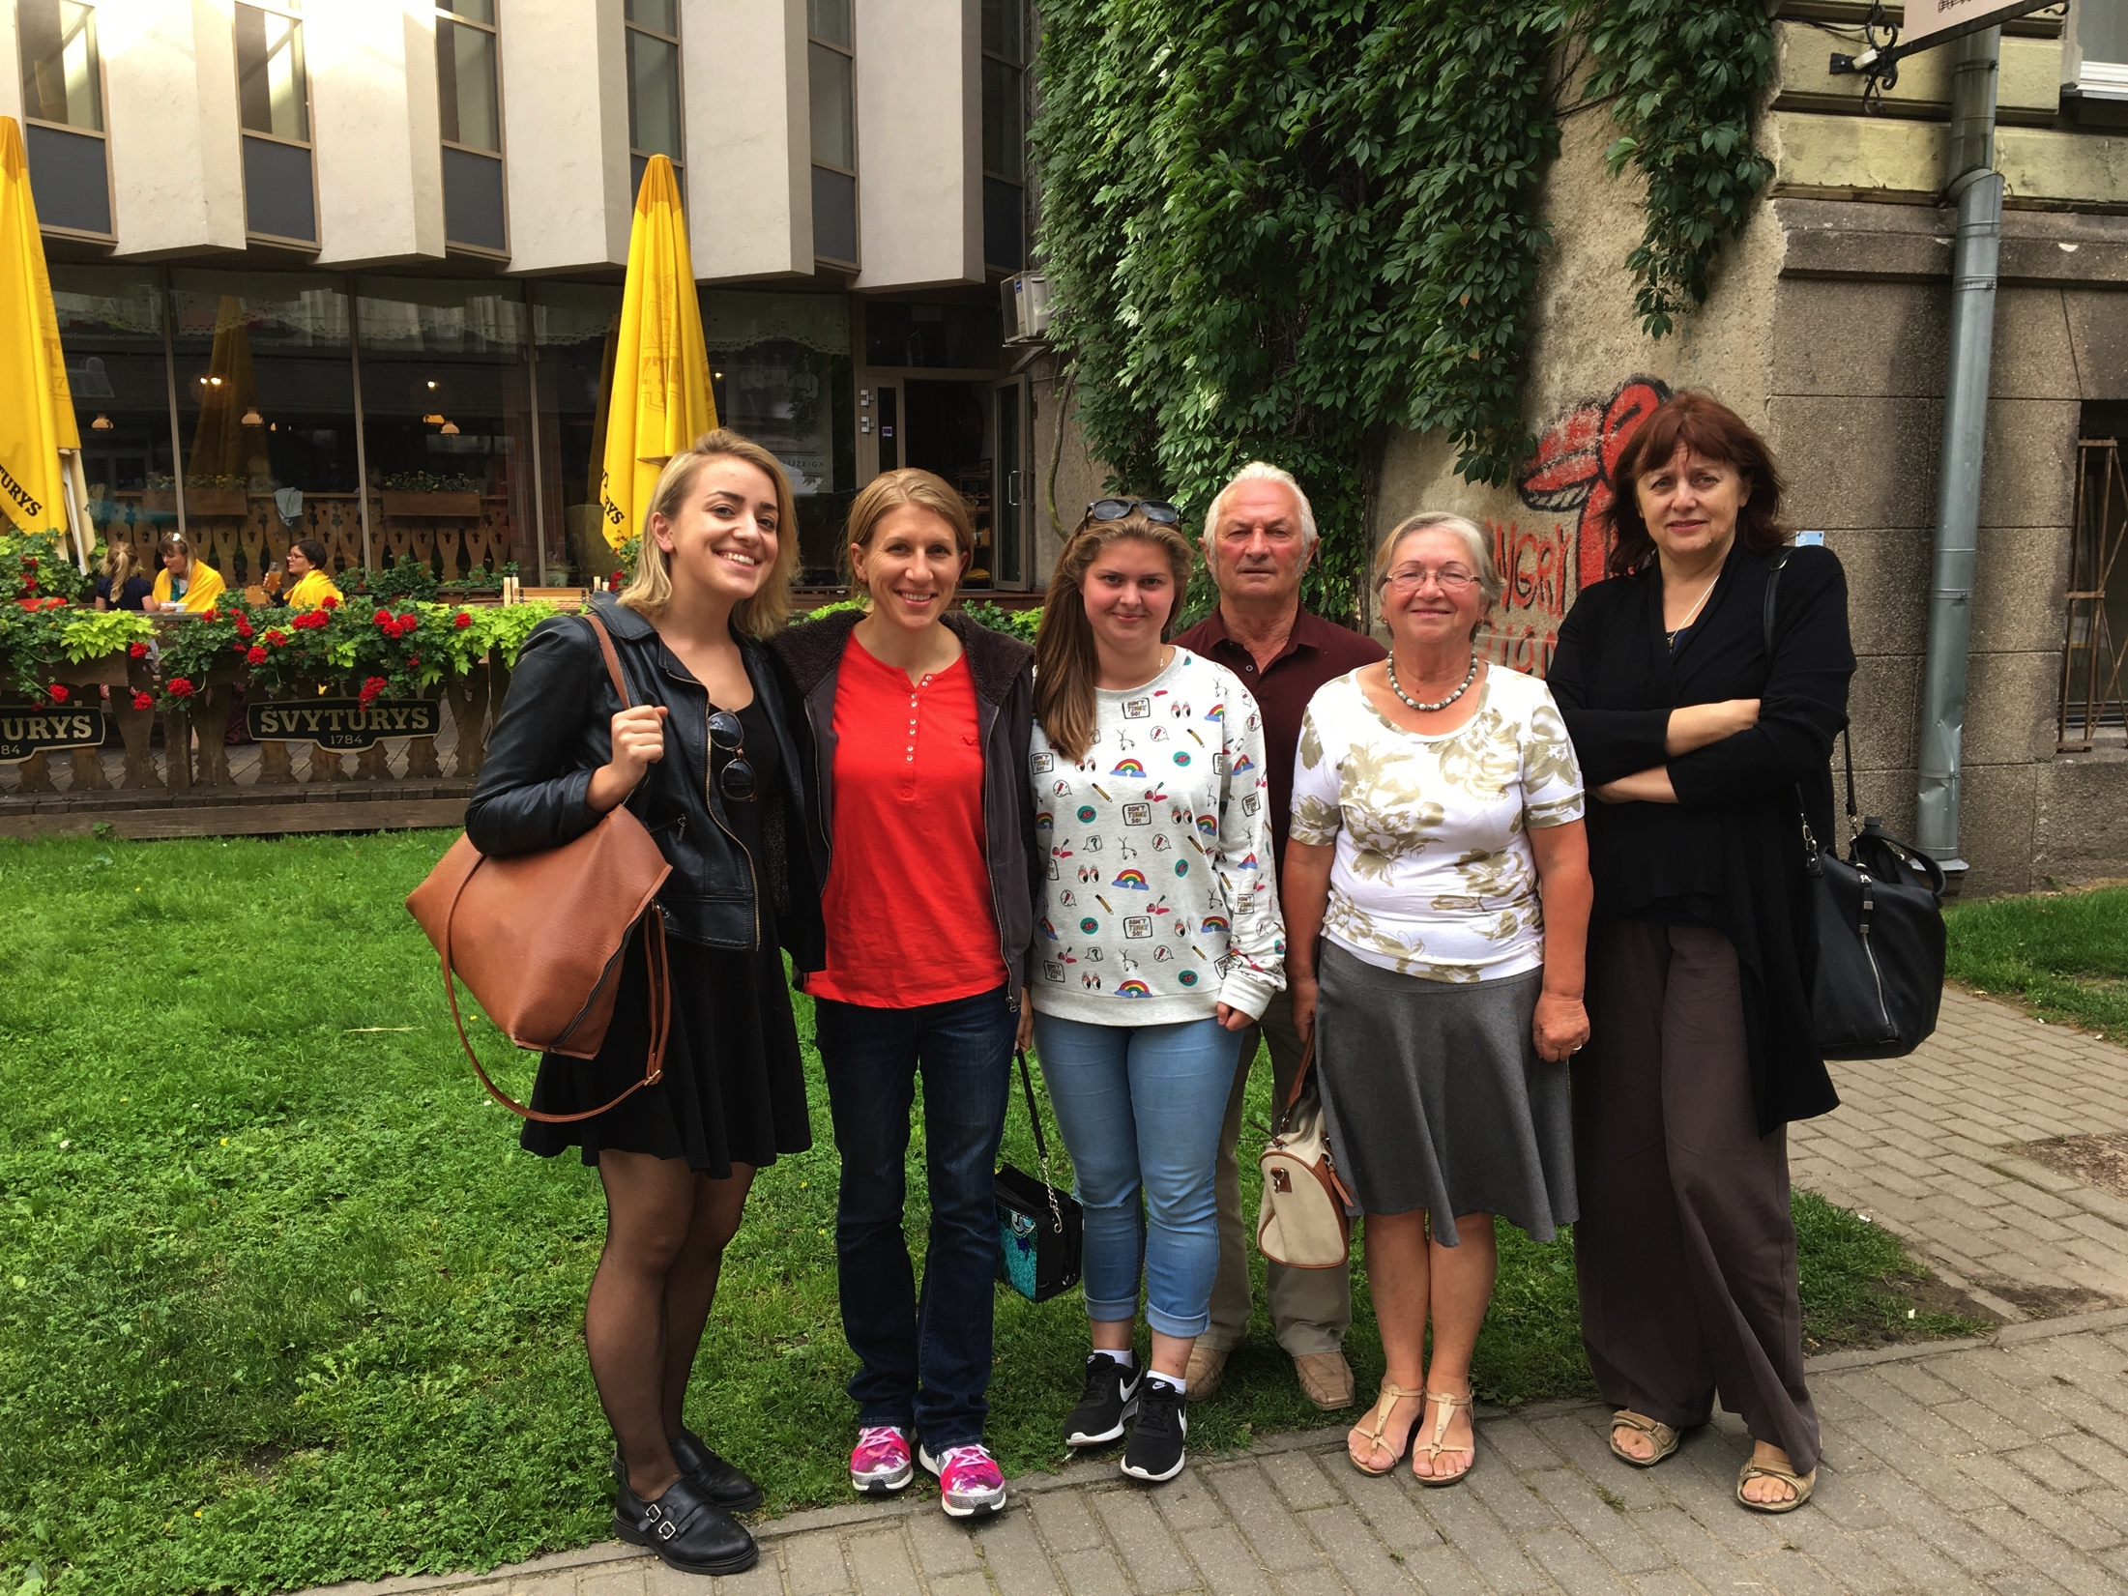
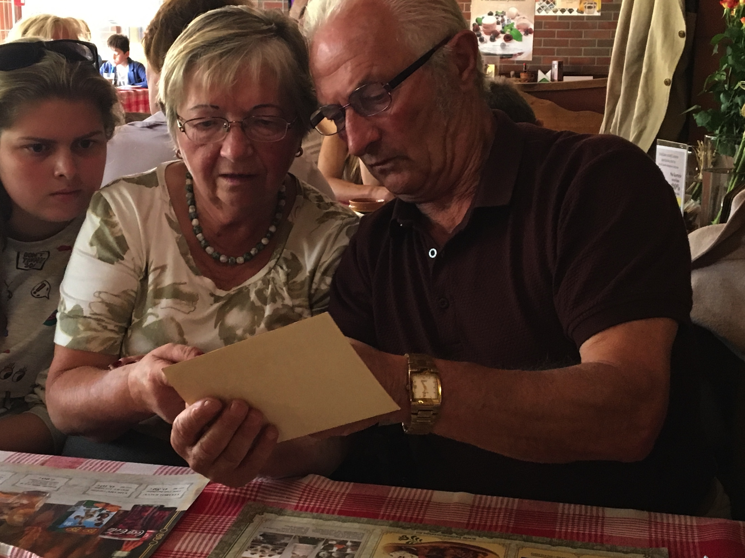
Mrs. Kamin

Slide 3

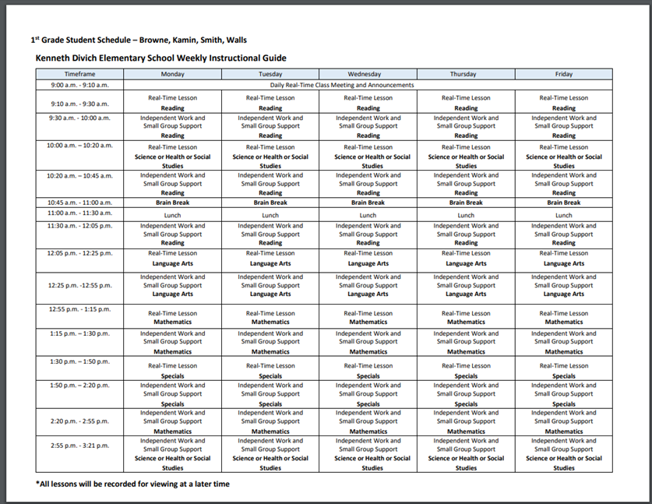
Daily Schedule
*Students who receive special education services will receive a schedule for those services from their case manager.

Slide 4
Suggested Supplies for Home
Technological device with internet
Pencils
Crayons
Scissors
Gluestick
Optional: headphones with mic
Printer
Some supplies will be provided by the teacher

Slide 5
Specials Schedule
DAY A – Music or Computer Science
DAY B – Art or Theatre
DAY C – PE or Theatre
DAY D – Library or Music
DAY E – Art or Computer Science
DAY F -- PE
DAY G – PE or Library

Slide 6

Grading
Items will be graded as follows:
Class Work - 15%
Quizzes/Tests - 85%
Learner Behaviors:
E- Excellent
S- Satisfactory
N- Needs Improvement
Students will be graded using the following:
A - 90%-100%
B - 80%-89%
C - 70-79%
D - 60-69%
F - below 60%
W - Working below standards
Minimum F score- 50%

Slide 7

Infinite Campus
Grades and any up-to-date academic information is available on Infinite Campus at all times. If you do not have a login for this, please see the front office. This will follow your child to middle school and high school.

Slide 8

Attendance
Daily attendance will be taken each day throughout our distance learning journey. Students need to meet one of the three requirements below to be considered present each day.
The student makes progress in their classwork leading to mastery of grade level standards.
The student participates in a LIVE class session.
The student meets with or communicates with a licensed teacher or substitute who is able to discuss academic progress in any content area.

Slide 9
Class Dojo
This free app will be used as our school-wide communication tool. Invitations will be sent to connect you with your child’s teacher.

Slide 10
Divich Core Values
Our 4 core values at Divich Elementary
Be Respectful
Be Responsible
Be Safe
Be Engaged

Slide 11
Helpful Links
Parent and student implementation guide https://ccsd.net/schools/back-to-school/index.php
Access to lessons and assignments https://ccsd.instructure.com/login/ldap
To reset student login https://myaccount.ccsd.net/#/

Slide 12

Thank you!
Thank you for viewing this presentation. We know this will be a positive year for your child as we all work together to build on past achievements. Thank you for your support in making this year a success for your child!
Best ways to contact Ms. Walls
Email almycr@nv.ccsd.net
Send me a message using ClassDojo

